Slide 1

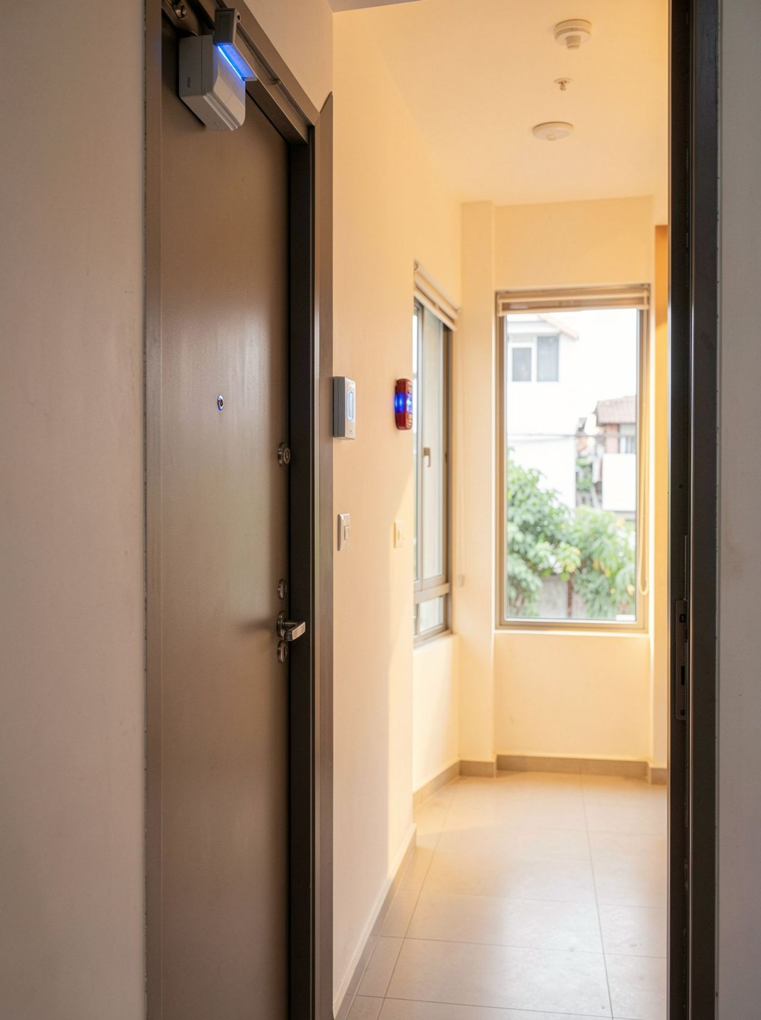
DIGITAL LOGIC · FINAL PROJECT
Design and
Simulation of a
Smart Home
Security System
From intrusion inputs to a verified alarm output
Team members; Under Supervision of ;
G.Kundana Reddy-2620030189 Dayarnab Baidya
K.Pravalika-2620030186
Vasu Akshita-2620030222
K.Deeksha Reddy-2620090126
M.Sharanya-2620030228
01 / 07
Notes:
Introduce the project as a digital logic system that converts real-world intrusion events into a controlled alarm response. State the team and section, then preview the journey from Boolean design to Logisim simulation.

Slide 2
Security begins with one clear decision
PROJECT 01
Smart Home Security
A protected entry should trigger the alarm only when the security system is armed.
OBJECTIVE
1
Detect intrusion
Inputs are door sensor D, window sensor W, motion sensor M, and arm signal S.
2
Control the response
The alarm output A becomes HIGH when a protected entry is triggered while the system is armed.
3
Verify the design
Translate the requirement into Boolean logic, then verify it in Logisim.
Digital logic · System definition
02 / 07
Notes:
Begin with the requirement, not the gates. The system must distinguish between an intrusion and an authorized, disarmed state. The four inputs and one output define the complete problem.

Slide 3
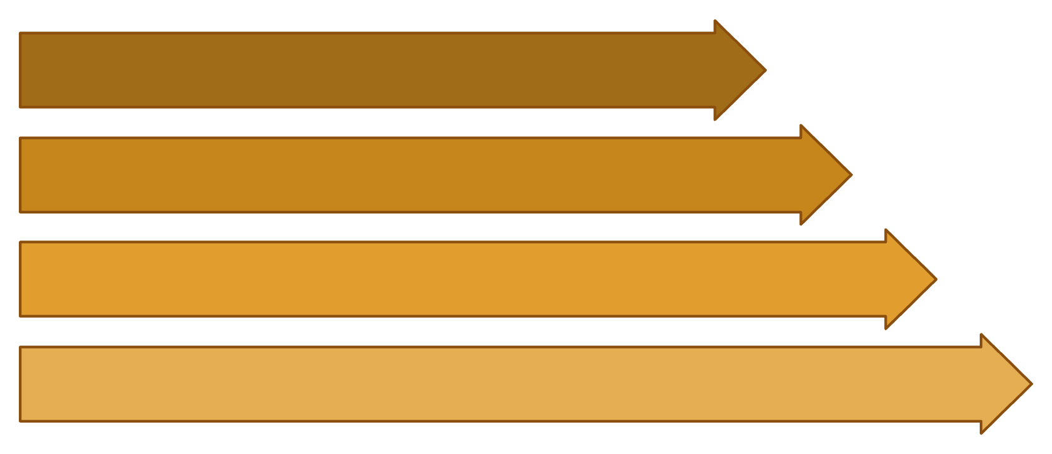
The alarm logic combines detection with system status
PROJECT 02
Smart Home Security
THEORY
CORE EQUATION
A = S(D + W + M)
D W M
I = OR
I = D + W + M
The OR gate detects any active sensor.
A = S · I
The AND gate blocks the alarm whenever the system is disarmed.
I · S
A
Boolean logic · Signal flow
03 / 07
Notes:
Walk from left to right. Any sensor can create the intrusion condition I, but the final alarm requires S as well. This is the central safety property: detection alone is insufficient when the system is disarmed.

Slide 4
Logisim turns the Boolean equation into a working circuit
PROJECT 03
Smart Home Security
IMPLEMENTATION
Arm S
1
Place input pins D, W, and M; connect them to a 3-input OR gate.
INPUTS
OR
AND
2
Connect the OR output I to one input of a 2-input AND gate.
D · W · M
I
I · S
A
3
Connect arm input S to the second AND input.
Toggle an input pin to represent a sensor state.
4
Connect output A to an LED or output pin labeled ALARM.
Logisim · Circuit construction
04 / 07
Notes:
Explain that Logisim makes each Boolean term visible. The three sensor pins feed the OR gate, the arm switch enters the AND gate, and the LED provides an immediate visual alarm output.

Slide 5
Simulation confirms the alarm responds only when armed
S | D | W | M | A
0 | 0 | 0 | 0 | 0
0 | 1 | 1 | 1 | 0
1 | 0 | 0 | 0 | 0
1 | 1 | 0 | 0 | 1
1 | 0 | 1 | 0 | 1
1 | 0 | 0 | 1 | 1
1 | 1 | 1 | 1 | 1
SIMULATION EVIDENCE
[Insert actual
Logisim screenshot]
PROJECT 04
Smart Home Security
SIMULATION
Truth table · Verification
Replace this placeholder before submission.
S = 0: alarm stays LOW for every sensor combination.
S = 1: any active sensor makes A = 1.
Representative input-output combinations
05 / 07
Notes:
Use the table to prove both halves of the requirement. The first two rows show that disarming suppresses the alarm, even when all sensors are active. The remaining rows show that arming plus any active sensor produces a HIGH output.

Slide 6
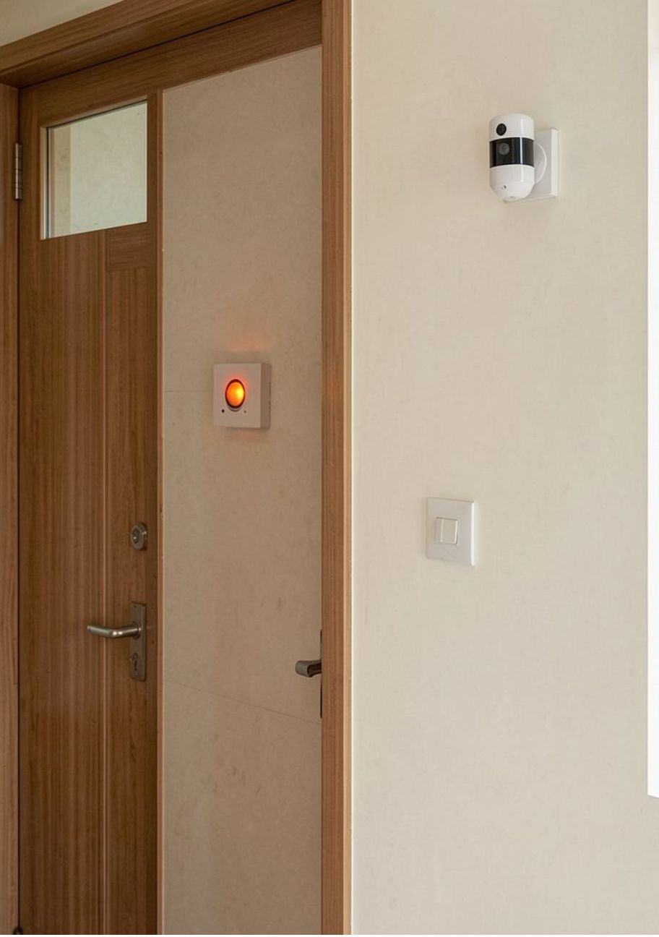
The design is simple, scalable, and ready for improvement
PROJECT 05
Smart Home Security
CONCLUSION
A = S(D + W + M) is implemented and its expected truth-table behavior is validated.
APPLICATIONS
IMPROVEMENTS
Home entry protection, room monitoring, laboratory security, and small-office alarm systems.
Panic button, buzzer and siren outputs, alarm latch, password-based arming, or a microcontroller interface.
Before the viva: demonstrate sensor toggles in Logisim and upload the project file to the team’s existing GitHub repository.
Replace bracketed team details and the simulation placeholder with your final project evidence.
Applications · Next steps
06 / 07
Notes:
Close by restating the validated equation and then separate current capability from future improvement. The final evidence checklist is practical: update the personal details, replace the screenshot, demonstrate the toggles, and upload the Logisim file.

Slide 7
DIGITAL LOGIC · FINAL PROJECT
Thank You
Thank you for your attention. We welcome your questions.
07 / 07
Notes:
Thank the audience and invite questions on the Boolean design, the Logisim circuit, or the simulation results.

